Slide 1
DRUG ADDICTION AMONG TEENAGERS
PRESENTATION BY:
IFRA EJAZ (21L-7508)
SUFYAN ALI (21L7541)
MUDASSIR ALI (21L-5474)
ABDULLAH TAHIR (21L-5419)

Slide 2
Introduction
Drug addiction affects between 3.4 and 6.6% of the population worldwide
STANCE:
Drugs are harming the youth greatly.
WHAT ARE DRUGS?
Medicinal drugs
Sedative drugs

Slide 3
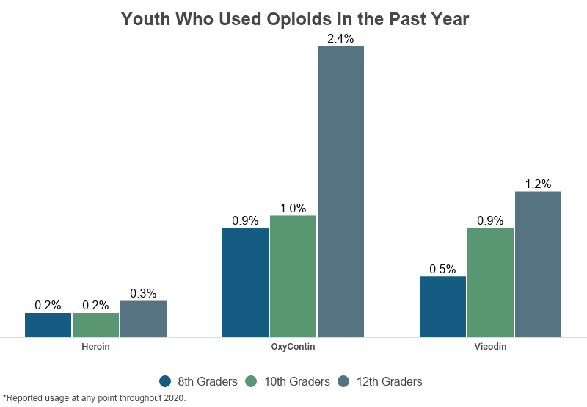
THESIS STATEMENT
Drug addiction is negatively influencing the youth by making them physically
inactive and ill, harming their mental health and creating a lack in their cognitive abilities.

Slide 4
HOW ARE DRUGS MAKING THE YOUTH PHYSICALLY DISABLED?
Drugs have a major contribution in damaging the physical health of a person especially in a young age.

Slide 5
PHYSICAL HARMS
Different types of drugs affect our body and physical health in different ways
Casual users do not consider it as a harmful activity.
Results in long-term health outcomes by damaging organs and spreading infections.
In 1995 alone, more than 2,000 youth (ages 15 to 20) were killed in alcohol-related car crashes (National Highway Traffic Safety Administration, 1997).

Slide 6
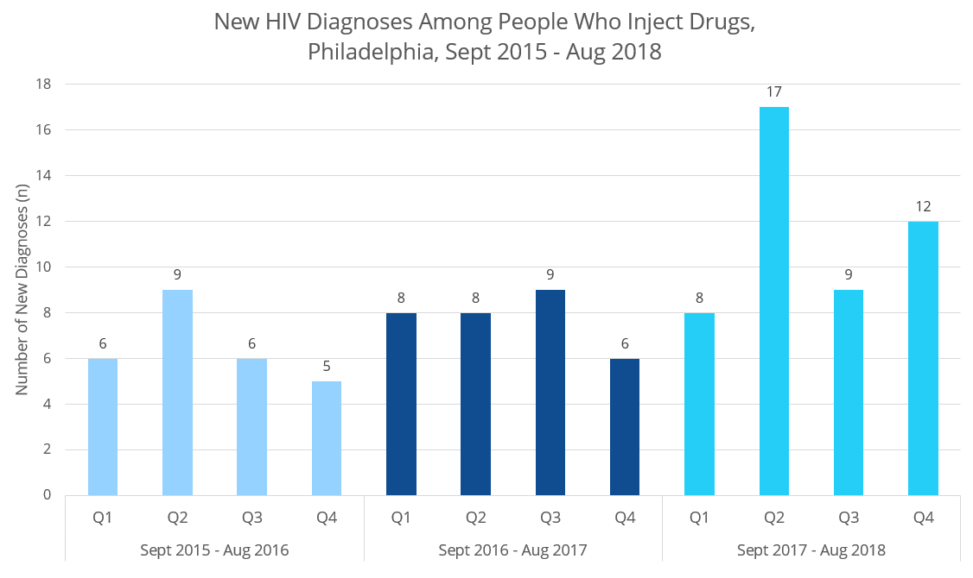
Nearly one-third of reported AIDS cases have been linked to injection drug use heroin, cocaine, or any drug that abusers inject. One way that HIV/AIDS, hepatitis, and other infectious diseases are spread is through the sharing of needles or other injection equipment.

Slide 7
WHY ARE YOUTH THE MOST EASILY AFFECTED BY ADDICTION?
Prolonged use of certain illicit drugs can result in long-term damage to mood and mental health.

Slide 8
PSYCHOLOGICAL HARMS
Develop a negative outlook about life.
Loss of motivation.
Problems with relationships.
According to a survey on drug use and health by the Substance Abuse and Mental Health Services Administration (SAMHSA), 9.2 million adults reported having a co-occuring mental illness and substance use disorder in 2018.

Slide 9
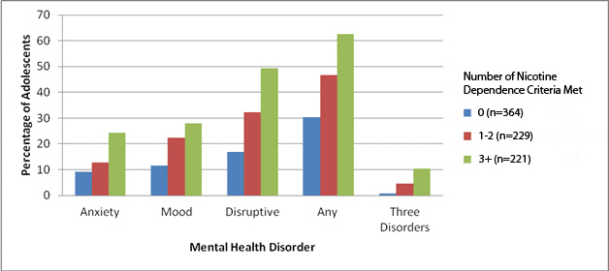
DRUG ABUSE AND INCREASED MENTAL HEALTH PROBLLEMS:

Slide 10
ARE DRUGS A DIRECT THREAT TO THE COGNITIVE SKILLS OF YOUTH?
Early drug exposure is associated with low cognitive performance of students.

Slide 11
LOW COGNITIVE PERFORMANCE
Short-term memory.
Likelihood to attend class.
Makes the youngsters indecisive and alters their reasoning abilities.

Slide 12
ALTERNATIVES TO REDUCE THE USE OF DRUGS:
Knowing how to resist temptation.
Learning how to cope with stress and relax without drugs.
Distracting yourself with activities like exercise or listening to music.

Slide 13
CONCLUSION
Drug addiction among youth is a common problem faced globally as it harms their psychological as well as physical health and hinders their capability to reason and learn new things. But adoption of some proper alternatives can help reduce the increased use of these drugs among the young people and save them from their harmful effects.

Slide 14
THANKYOU!

